Slide 1
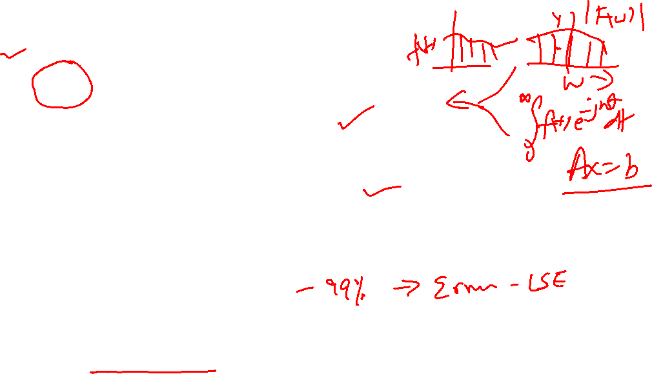
When both come together !!!!
Matrix (LA) and Fourier.
DFT.
FT-DTFT-DFT.
It is a sequence of Approximation.
Each approximation results in small errors.
Beauty is: LIFE is full of small errors.
Reality and Practicality also is like life in this.
Approximate, LSE, solutions are not only feasible but occupy the world of practice.
From Lunar orbits to CT Scan reconstruction.
The trick is “Small” error. { how small is small??}

Slide 2
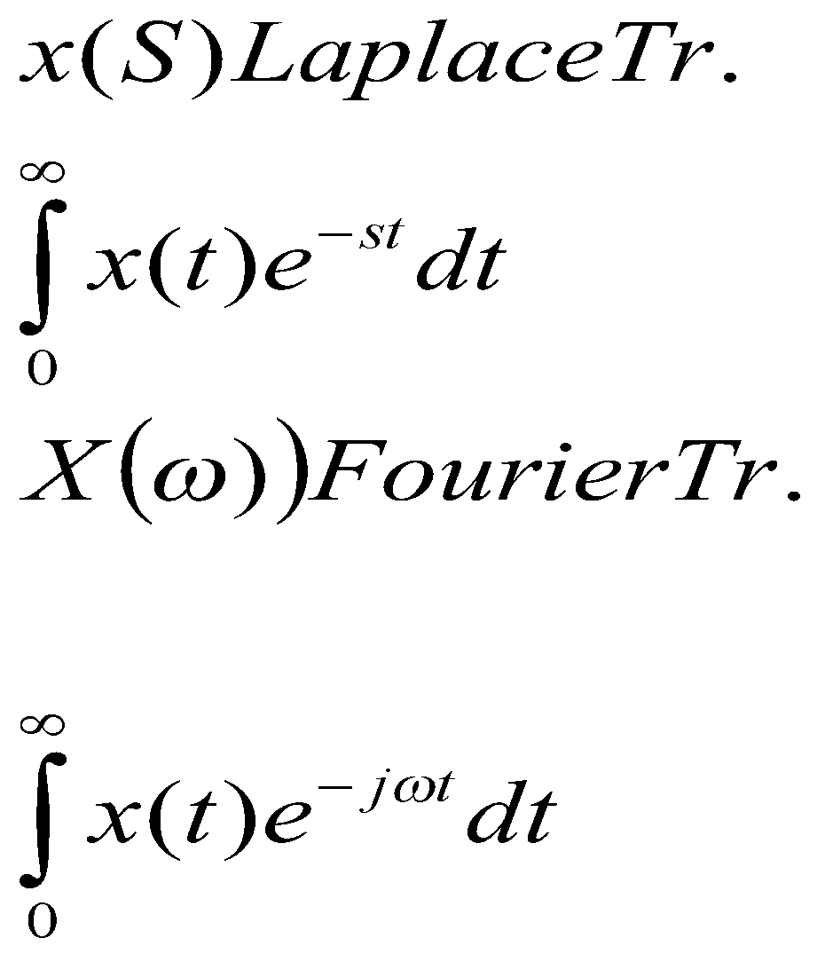
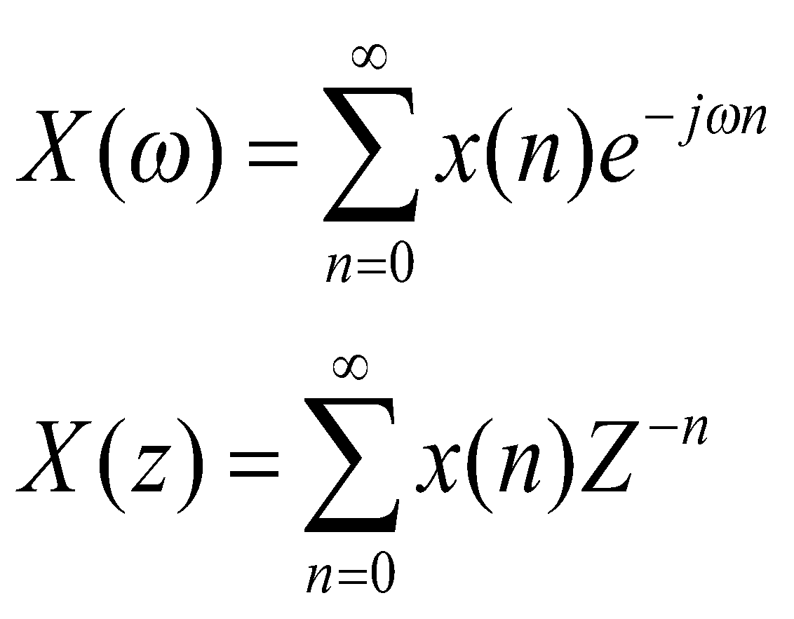
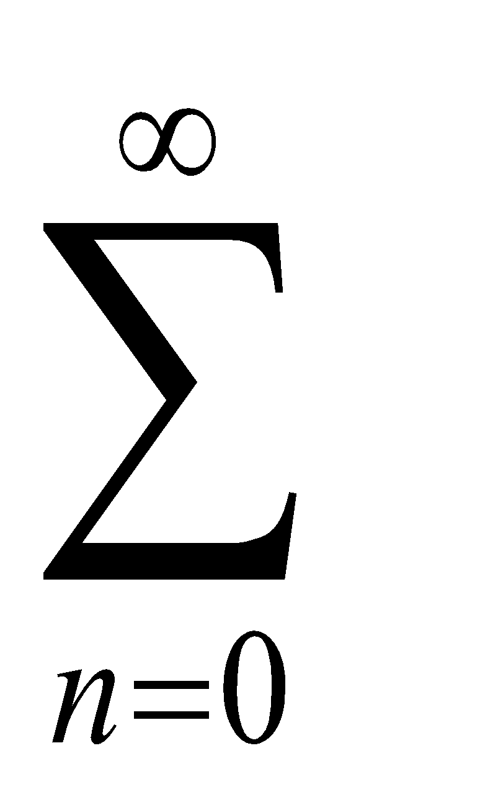

Fourier Transform Structure: FT to DFT
DFT
X(n)
X(k)
IDFT
Transform/Frequency Domain
X(t)
X(n)
For computation avoid
X(n)
X(k)
Also X(w) is continuous; Limited Use
Both Finite & Both Discrete
DFT

Slide 3
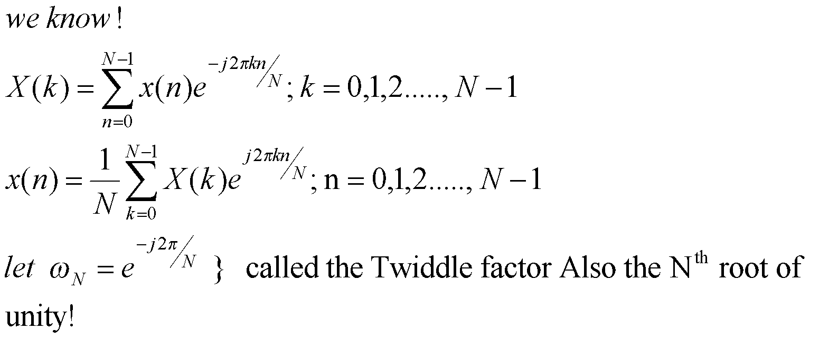
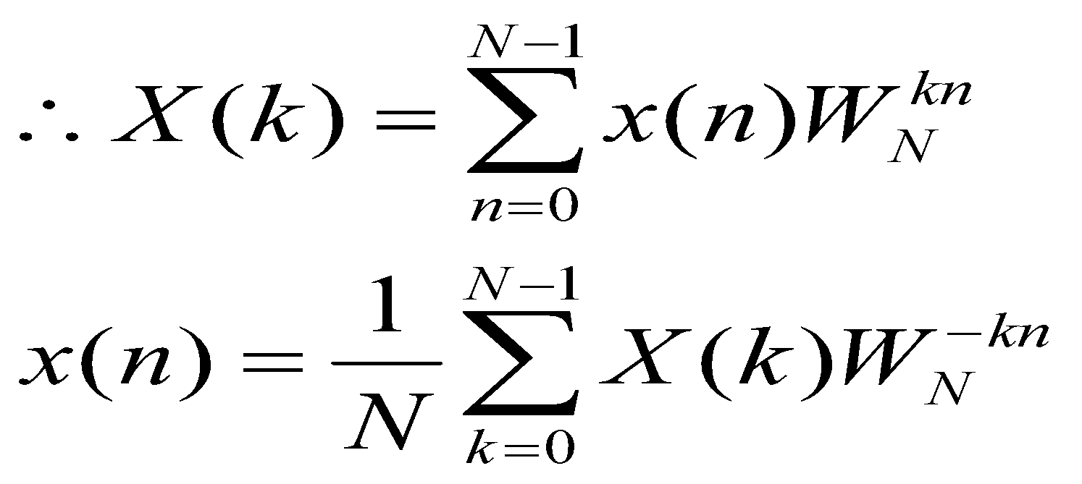
DFT as a linear Transformation:
Each take N complex multiplications. Therefore N-point -> N² complex multiplications.

Slide 4
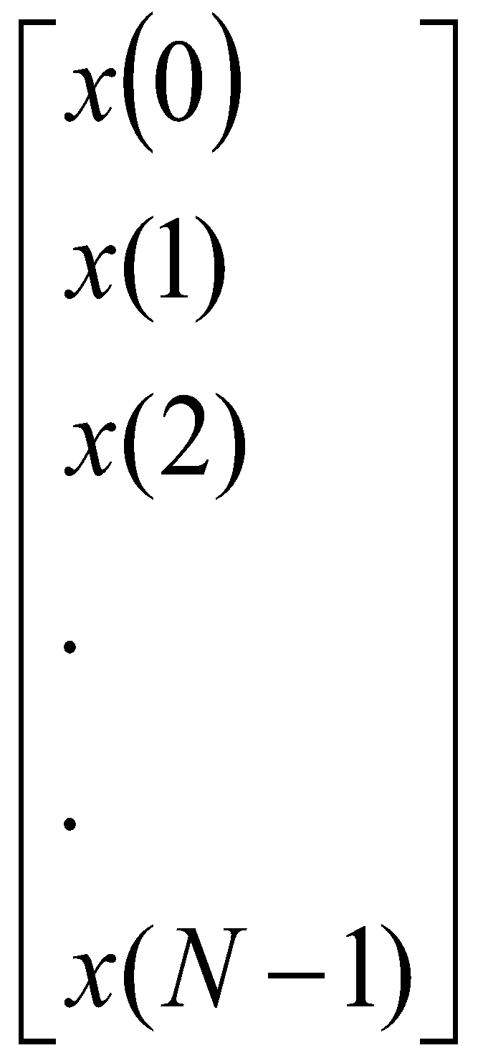
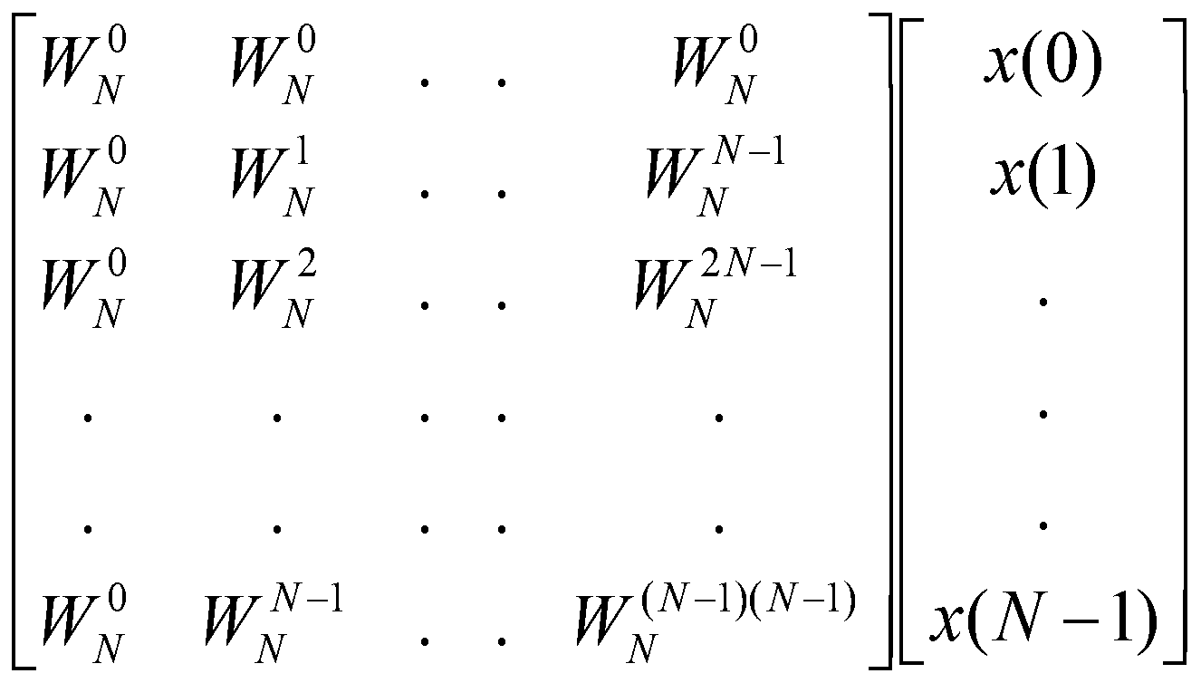
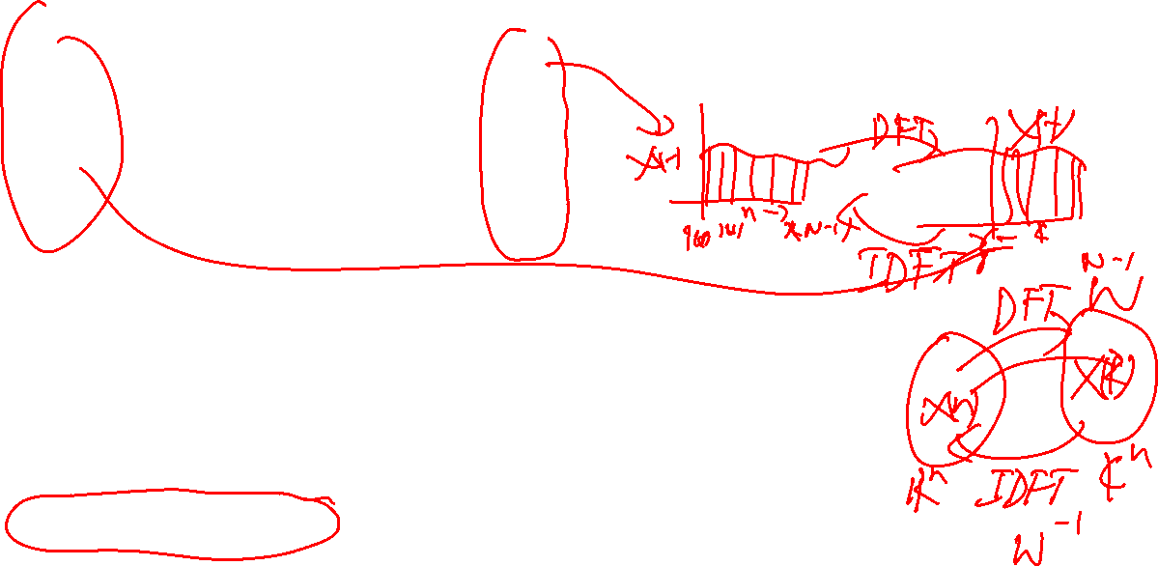
Continuing: for X(k)
k=1,2,..N-1 we get
B= AX type
Square N x N System !
X(k)=W x(n)
x(n)=W⁻¹ X(k)
Language of Linear Transforms
Vectors in C^{n} or R^{n} being manipulated
-Note the discrete Evaluation in still proportional to N², which is
prohibitive for large N. So what do we do?

Slide 5
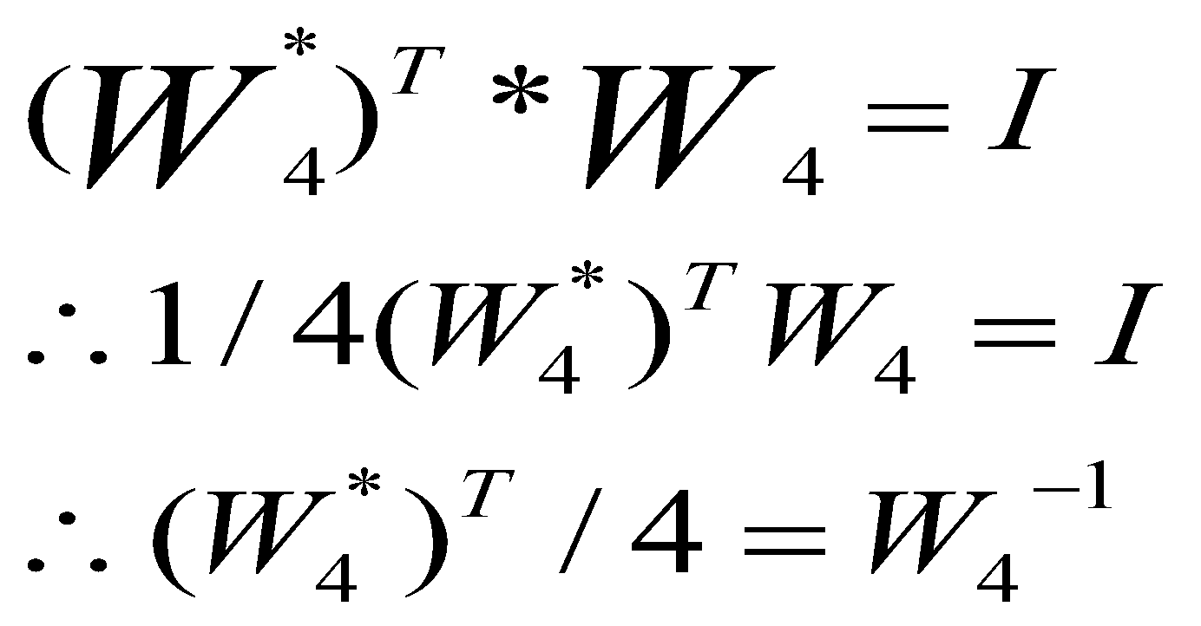
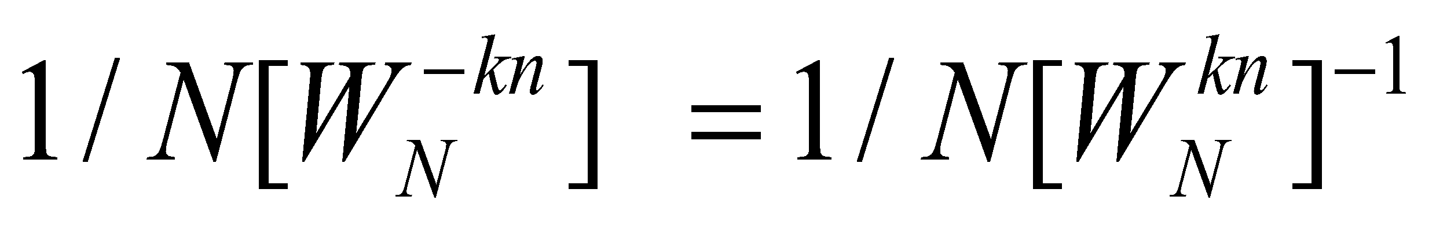
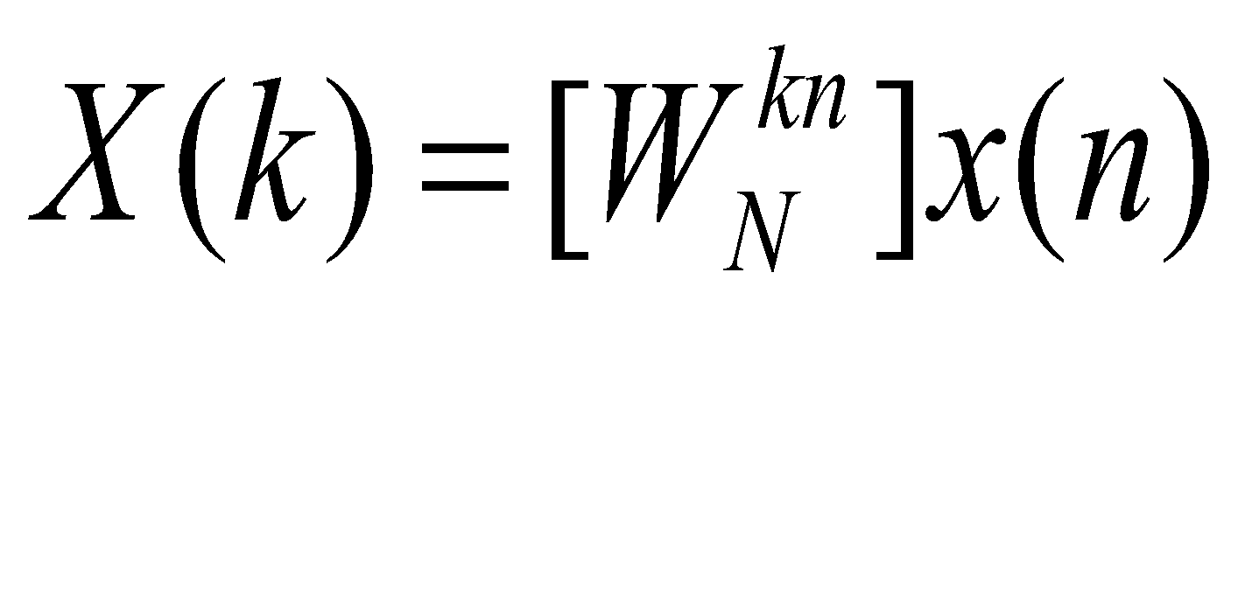
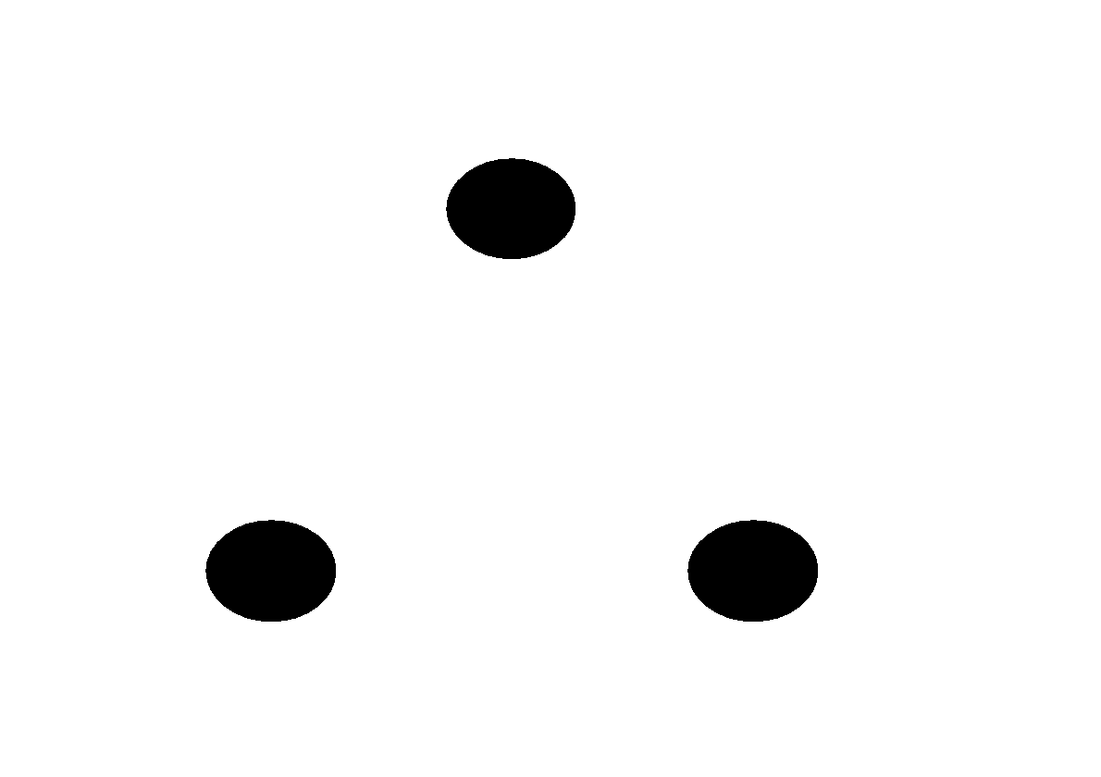
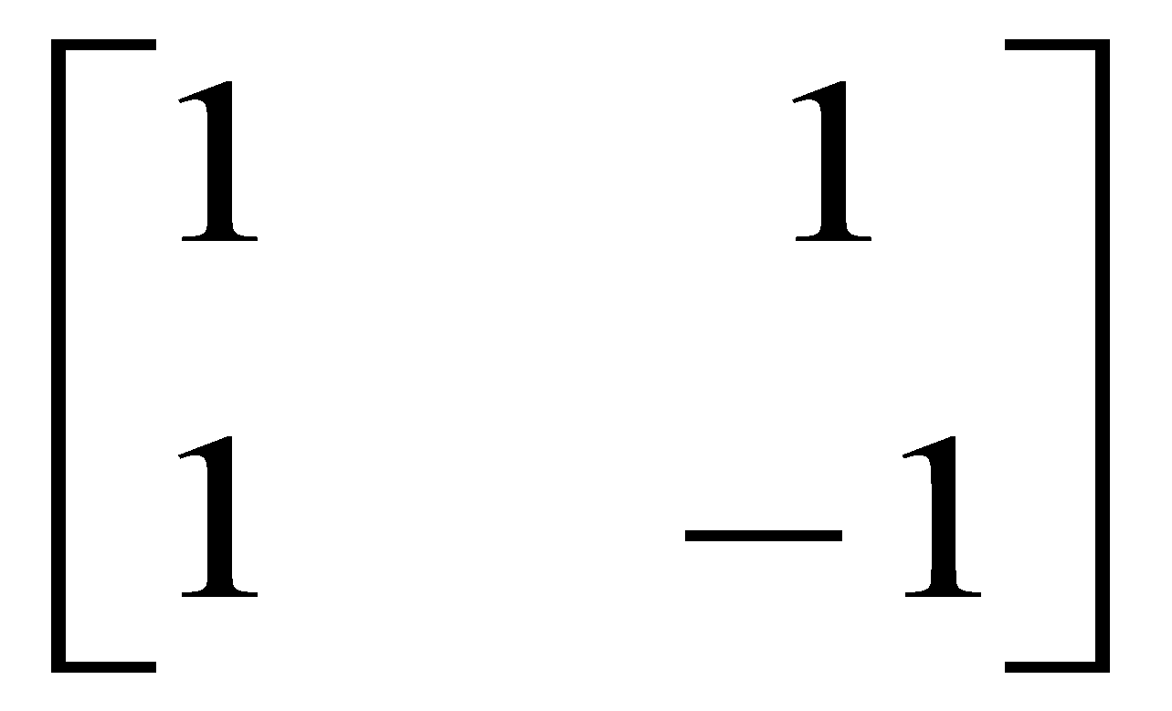
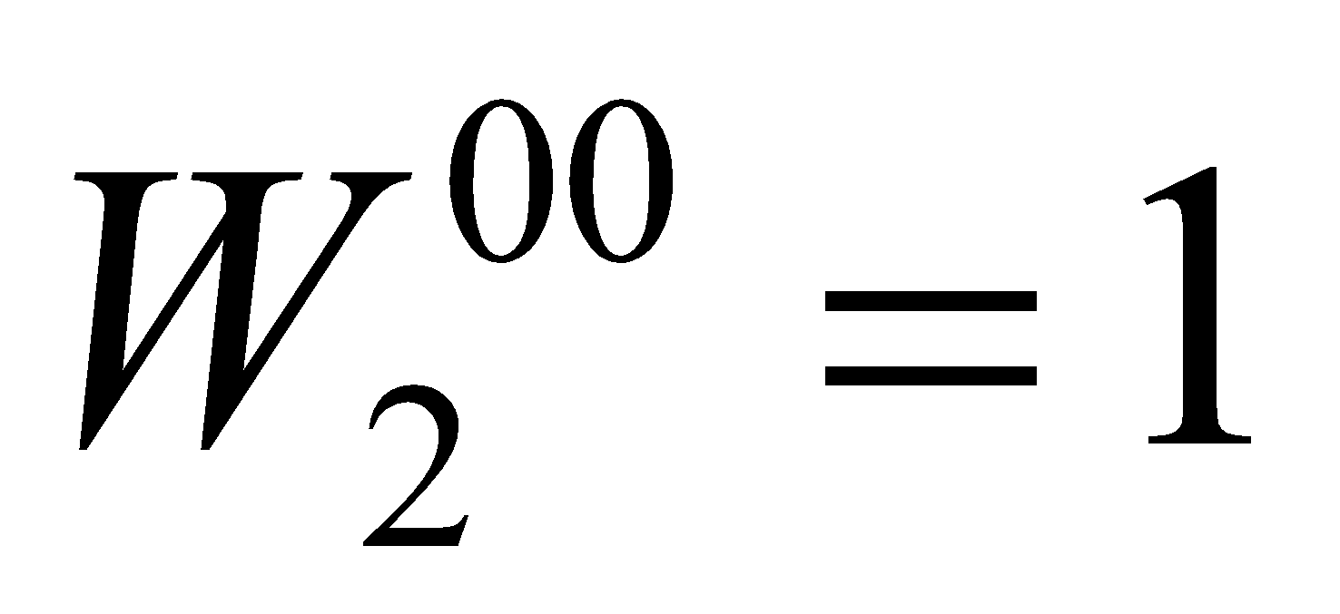
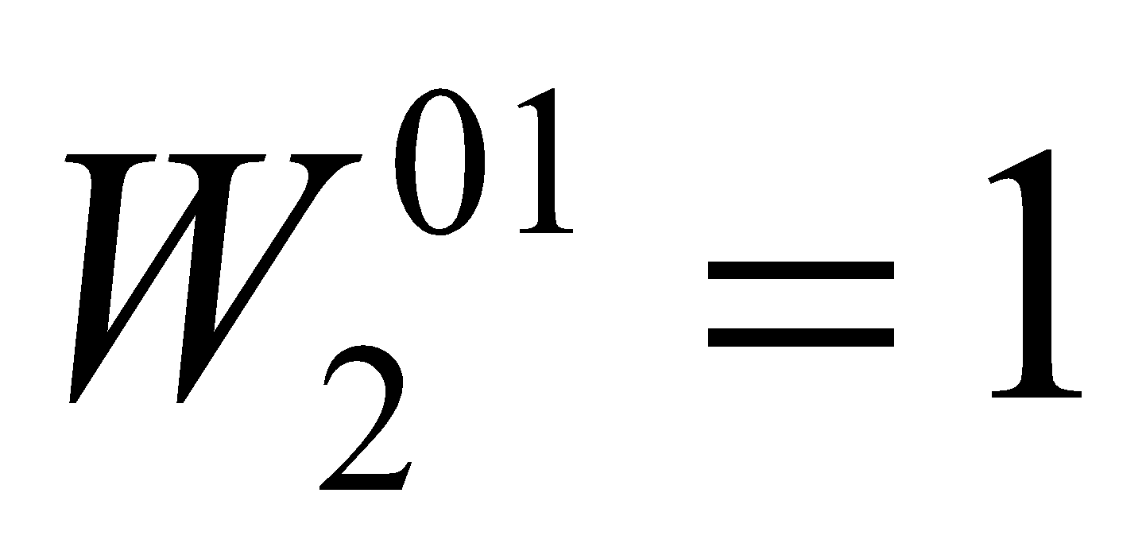
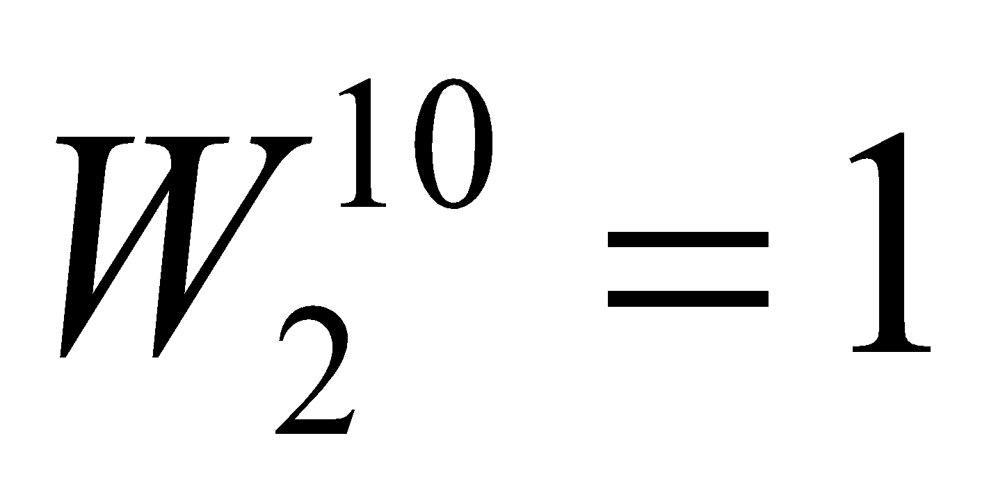
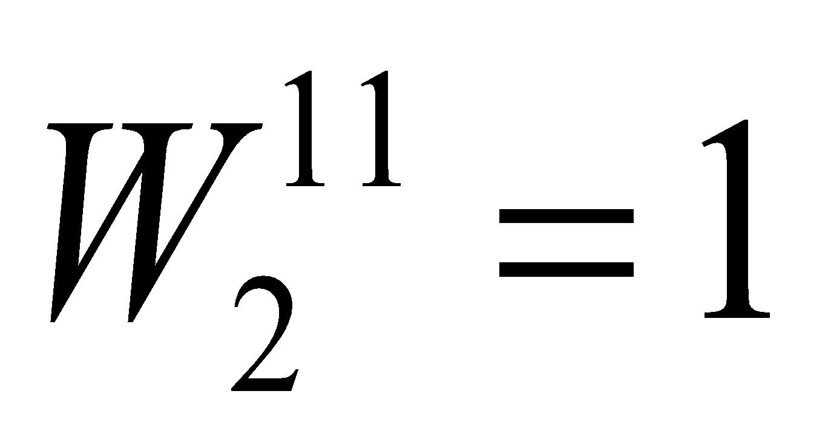
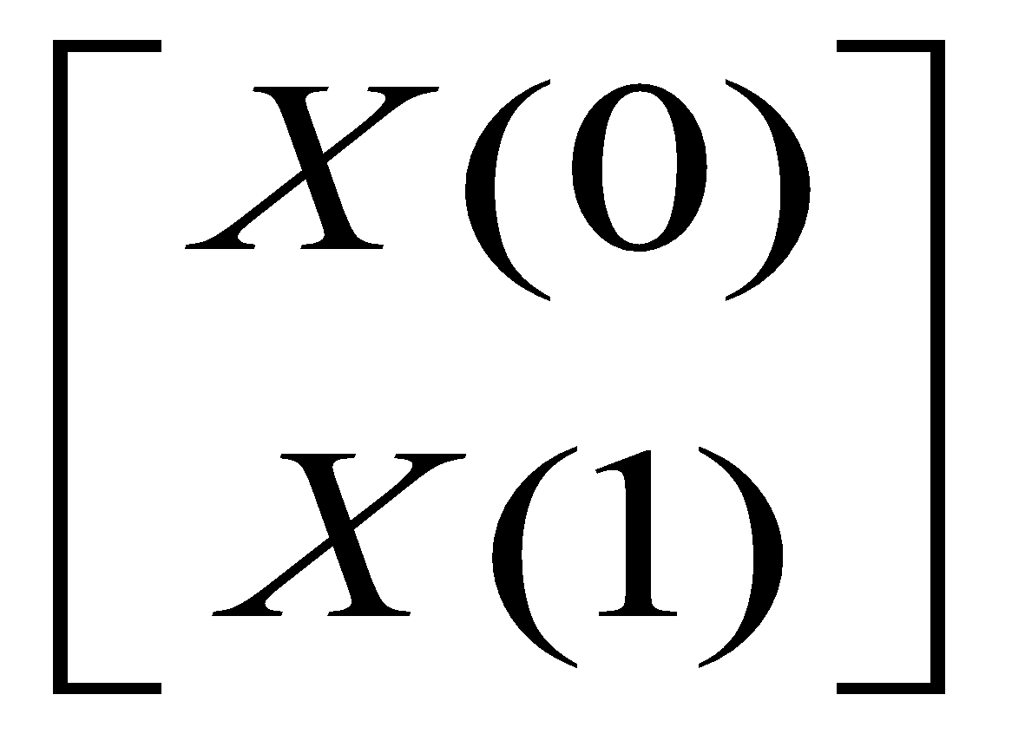
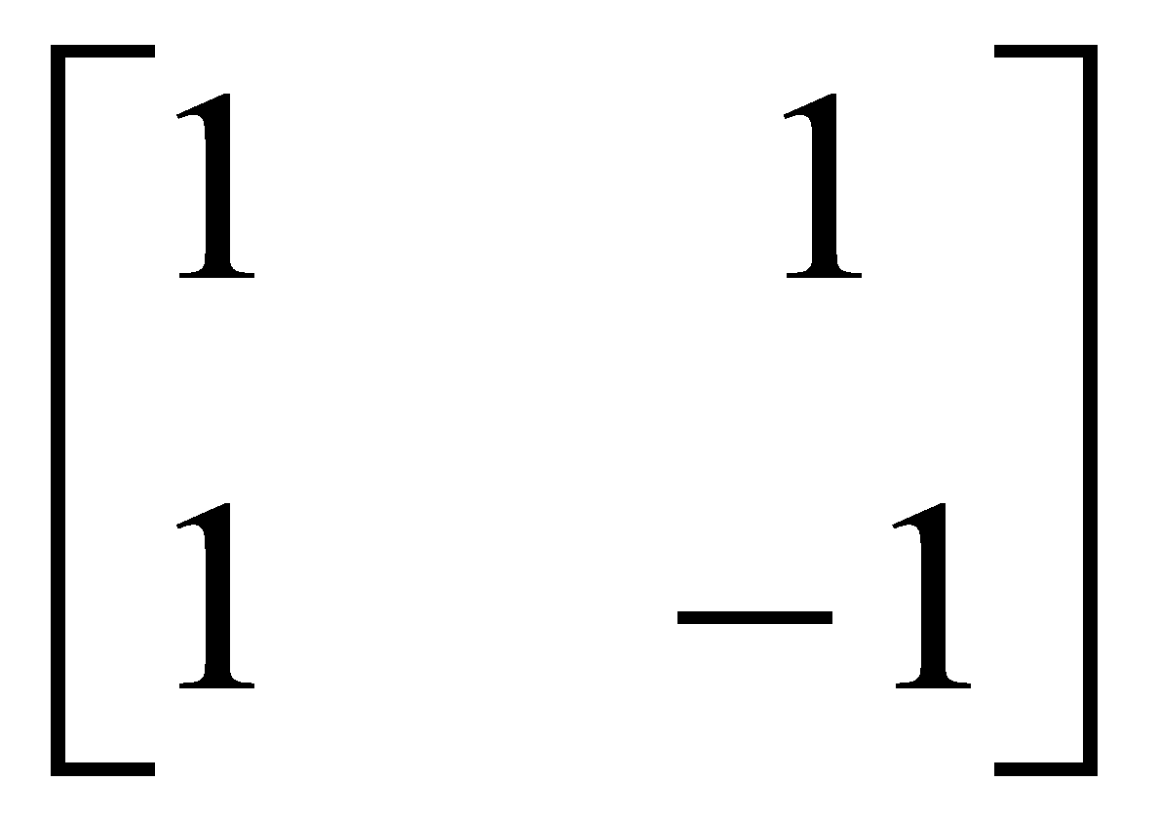
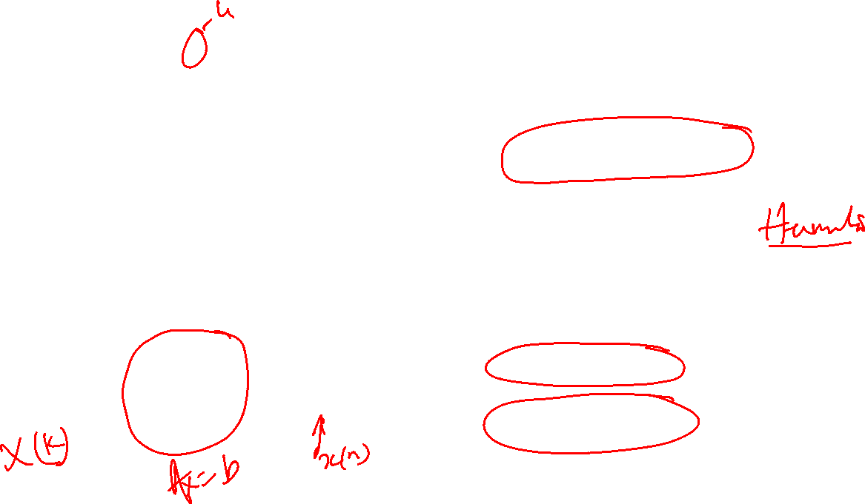
In general
Consider a special case
Architectural Viewpoint
N=2:
n=0,1
k=0,1
Nx1 NxN Nx1
>
X(0) = x(0) + x(1)
X(1) = x(0) – x(1)

Slide 6
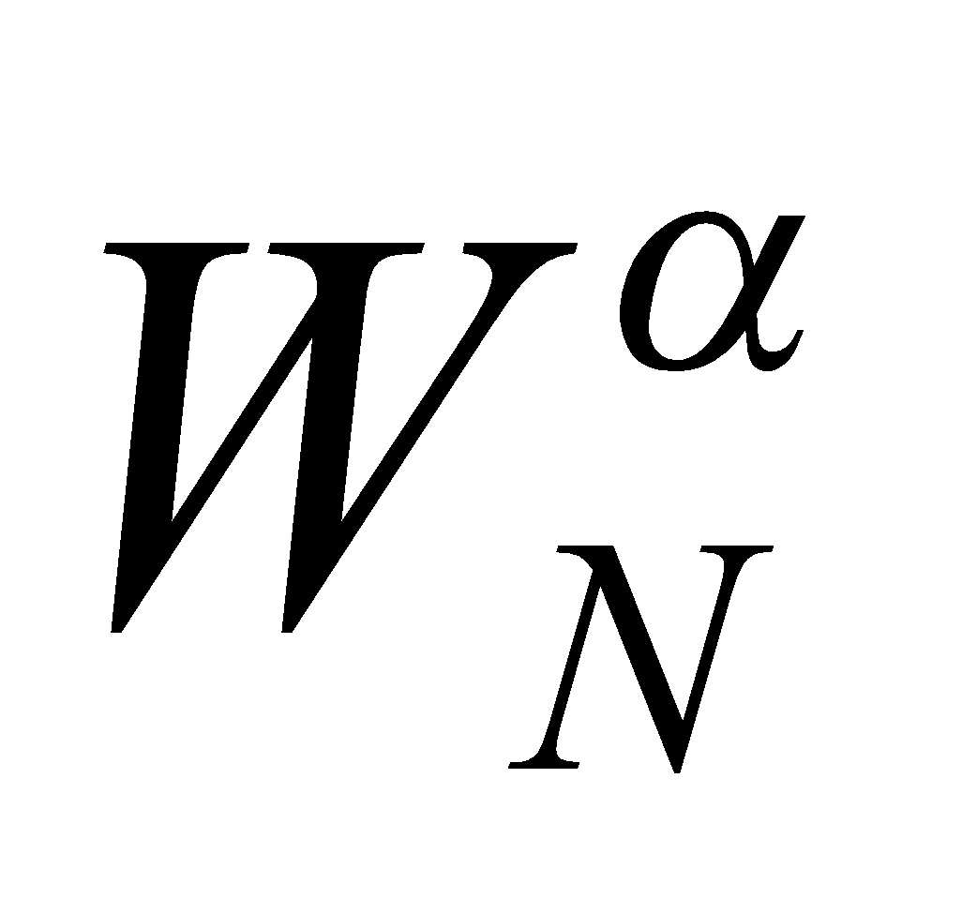

a
a
a+b
+
a+b
+
+
DIT
DIF
b
+
b
a-b
Algorithms
-1
a-b
-1
O(N²) to N log(N)
Cooley-Tukey
a
+
a+b
b
+
a+ b
Problem of Scaling,
Number/size representation
a
+
a+b
b
-1
+
x
(a-b)
Stage (j-1)
Stage ‘j’
Stage (j+1)

Slide 7
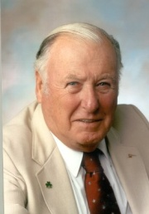
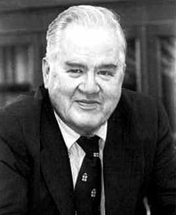
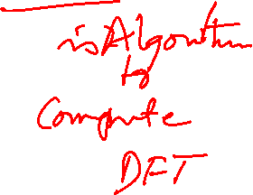
Fast Fourier Transform (FFT)
James Cooley John Tukey
FFT development motivated by cold war (to monitor Russian nuclear activities)
Uses the symmetry relations in the DFT to drastically reduce computations.
Made DSP practicable. One of the greatest algorithm in history of time.
Gauss had developed a very similar algorithm, in 1811 !

Slide 8
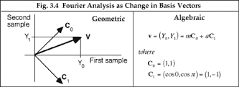
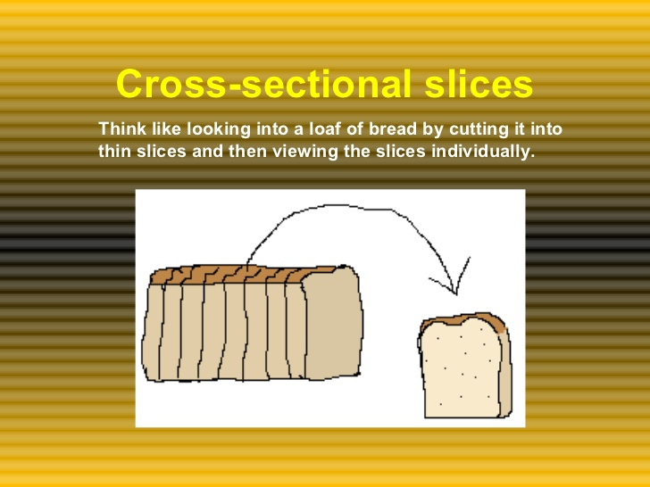
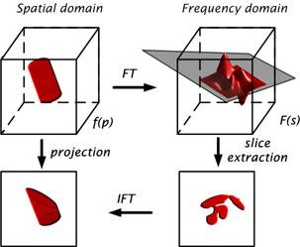
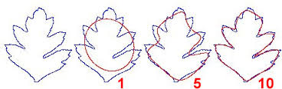
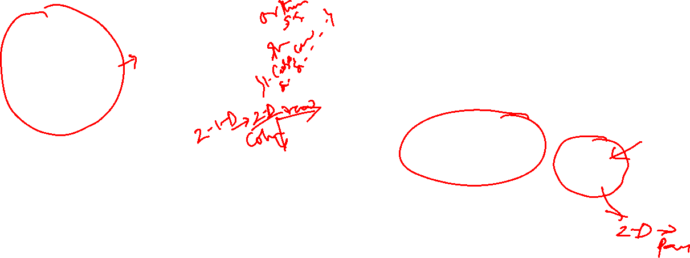
Better Way to do: LA approach “ Projection ”

Slide 9
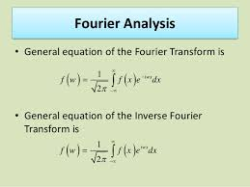

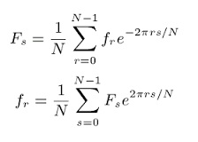
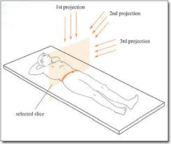

What Works !!!

Slide 10
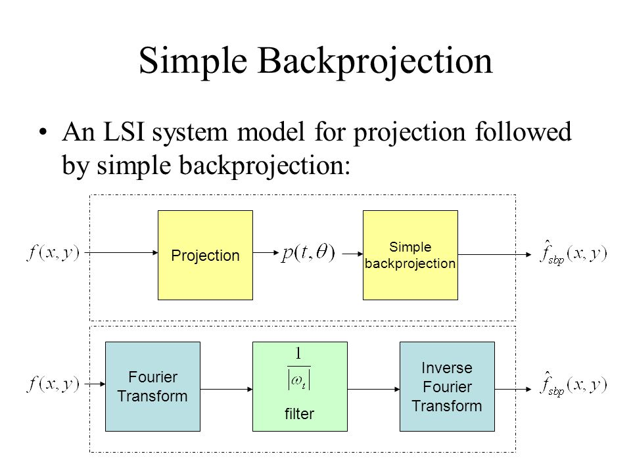
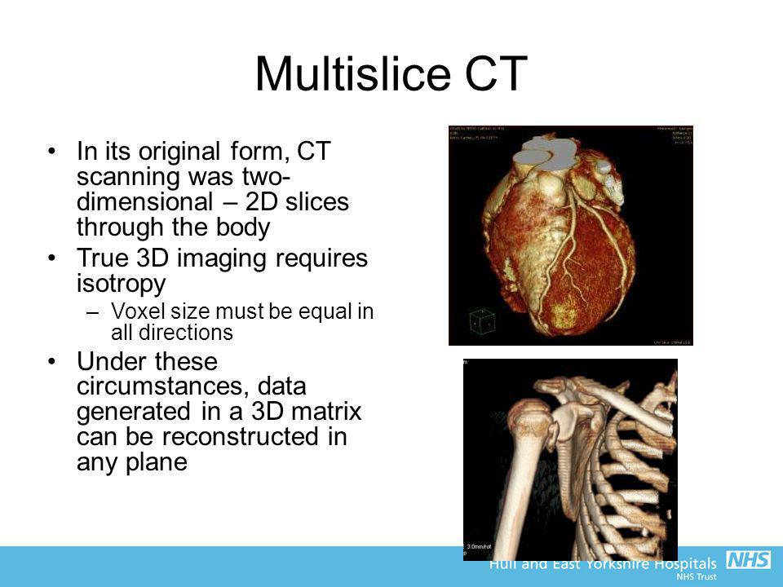
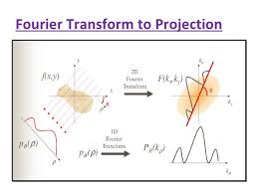
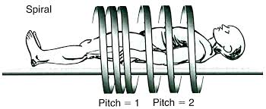
Discrete versions (1-D,2-D-3-D) dominate

Slide 11
Subspace methods in Data Representation (COMPRESSION)
Dr Ashok Rao
Former Head, Network Project, CEDT, IISc, Bangalore-560012, India
< ashokrao.mys@gmail.com >

Slide 12
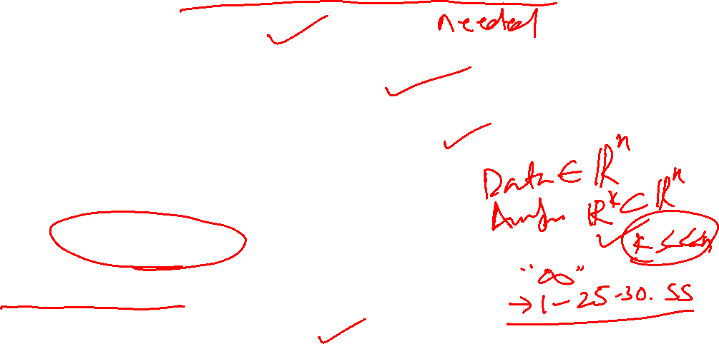
Standard methods
Key aspects are matrix Representation of data
Symmetry is advantages
Eigen value-Eigen vector concept
Invariant Subspaces, so variant part is automatically eliminated.
Projection (on to a ..SS) is a key component
Other Subspaces are also thus, feasible.
Provides a variety of flavors.

Slide 13
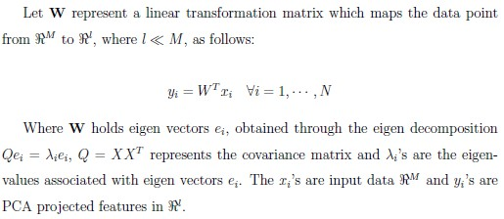

Principal Component Analysis (PCA)

Slide 14
How it works?
One small size PCA example in detail

Slide 15

Principal Component Analysis
Statistical Technique.
Identify Patterns in Data.
PCA involves the calculation of the eigenvalue decomposition of a data covariance matrix or singular value decomposition of a data matrix, usually after mean centering the data for each attribute.

Slide 16
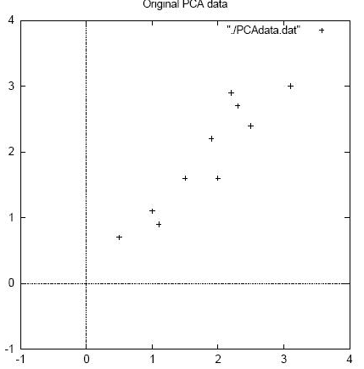
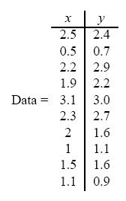
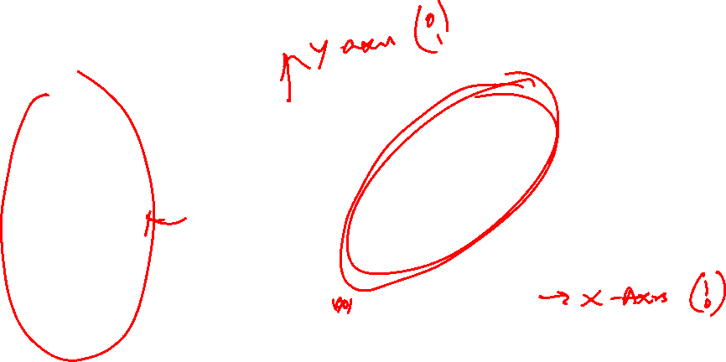
Algorithm
PCA can be summarized as follows:
Step 1: Get some Data

Slide 17
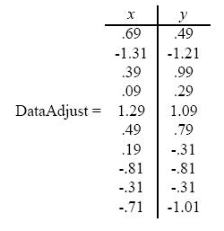

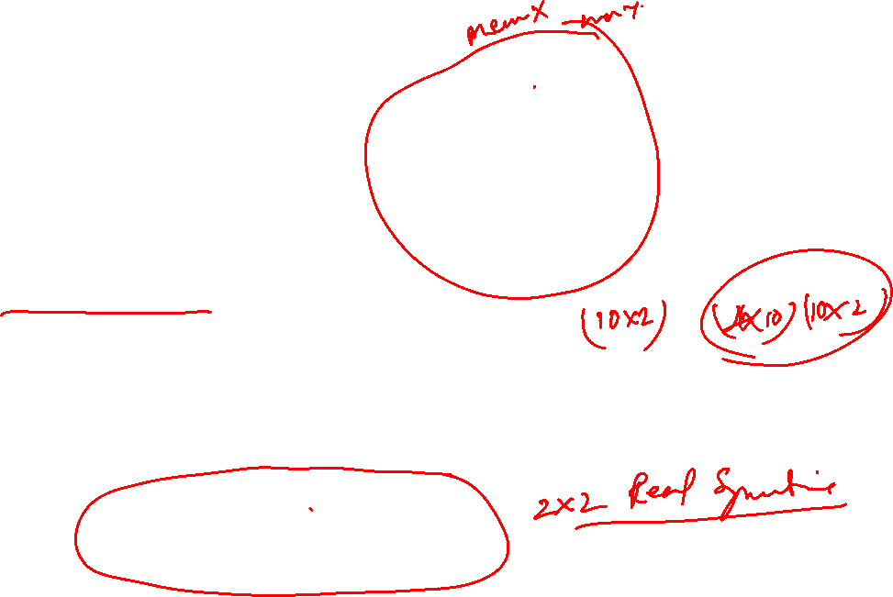
Step 2: Subtract the Mean
Step 3: Calculate Covariance matrix
Cov = 1/N × (DataAdjust^{T} ×DataAdjust)

Slide 18
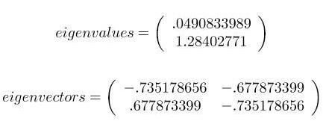
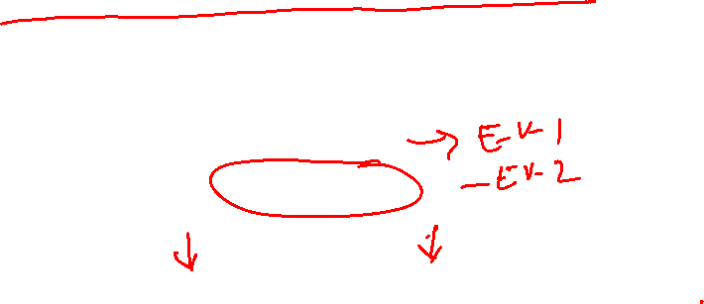
Step 4: Calculate Eigen values and Eigen vectors of covariance matrix.

Slide 19
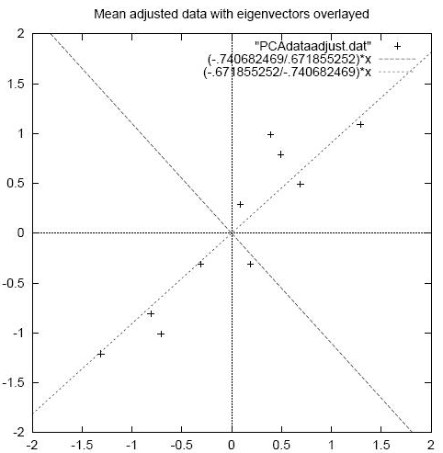
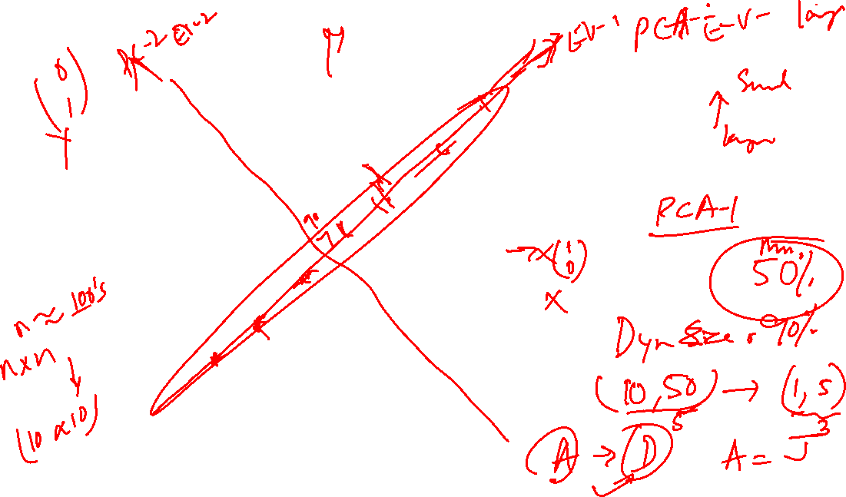

Slide 20
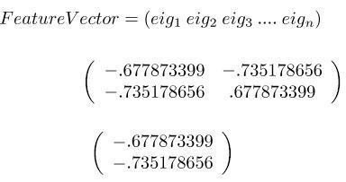

Step 5: Choosing component and forming feature vector
We choose the principal component as that Eigen vector which corresponds to largest Eigen value.

Slide 21
Step 6: Deriving the New dataset
Where,
RowFeatureVector is the matrix with the Eigen Vectors in the column transposed.
RowDataAdjust is the mean-adjusted data transposed.

Slide 22

More detailed, E & C Application
Engineering products, are just not simple or direct application of Analytical or Numerical methods.
Off course, critical idea in many cases stems from Analytical-Physics-Chemistry concepts, which while core of design, needs lot more of other ingredients to make it into useful product.
We will now show how Specifically Linear Algebra plays a dominant role in one such example. This is done in a very popular, E & C based, Entertainment product universally used.
** Few slides taken from Li & Drew: Fundamentals of Multimedia (Text Book).

Slide 23

Application using DCT via DFT
Spatial frequency indicates how many times pixel values change across an image block.
The DCT formalizes this notion with a measure of how much the image contents change in correspondence to the number of cycles of a cosine wave per block.
The role of the DCT is to decompose the original signal into its DC and AC components; the role of the IDCT is to reconstruct (re-compose) the signal.

Slide 24
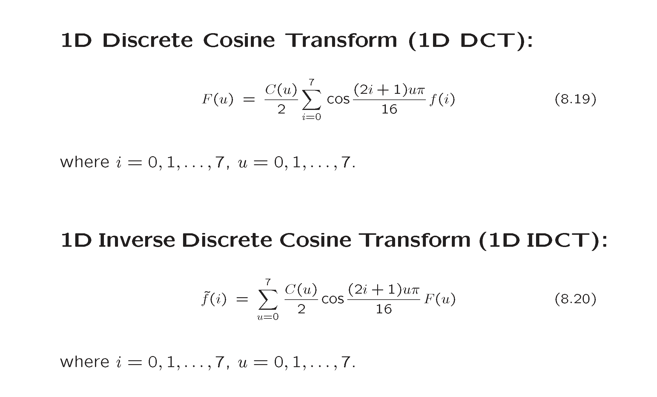


Slide 25


Slide 26



Slide 27


Slide 28


Slide 29



Slide 30



Slide 31


OBSERVE: Some Amazing Property, which is critical for Applications

Slide 32

We now want to convert this into a Product.
TAKE LITTLE HELP FROM COMPUTER SCIENCE.
What does Computing & Programming imply us to do.
Structure the process (Algorithm) , create standardized File format.
Partition the data to work on “manageable” portion of the problem.
Make the program work “repeatedly” on the structured format. Collect the result and sequence the answer for acceptance / display.

Slide 33

Strategy for using DCT
Standardize Size of block (2-D) or
the frame length (Audio)
Do DCT suitably on Image block (8 X 8) or Audio Frame (512 long) {DFT of even X (n)}
Freeze on Quantization tables, for Y, I, Q components of Video Image
Code each Image, in blocks, use tables and pack the resultant into a structured file.

Slide 34



